Slide 1
Cloud Computing

Slide 2
Course Objectives
To become familiar with Cloud Computing and its ecosystem.
To learn basics of virtualization and its importance.
To evaluate in-depth analysis of Cloud Computing capabilities.
To give technical overview of Cloud Programming and Services.
To understand security issues in cloud computing.
To be exposed to Ubiquitous Cloud and Internet of Things.

Slide 3
Course Contents
UNIT – I FUNDAMENTALS OF CLOUD COMPUTING 06 Hours
Origins and Influences, Basic Concepts and Terminology, Goals and Benefits, Risks and Challenges, Roles and Boundaries, Cloud Characteristics, Cloud Delivery Models, Cloud Deployment Models, Federated Cloud / Intercloud, Types of Clouds. Cloud-Enabling Technology: Broadband Networks and Internet Architecture, Data Center Technology, Virtualization Technology, Web Technology, Multitenant Technology, Service Technology.
UNIT – II VIRTUALIZATION AND COMMON STANDARDS IN CLOUD COMPUTING 06 Hours
Implementation Levels of Virtualization, Virtualization Structures/Tools and Mechanisms, Types of Hypervisors, Virtualization of CPU, Memory, and I/O Devices, Virtual Clusters and Resource Management, Virtualization for Data-Center Automation.
Common Standards: The Open Cloud Consortium, Open Virtualization Format, Standards for Application Developers: Browsers (Ajax), Data (XML, JSON), Solution Stacks (LAMP and LAPP),Syndication (Atom, Atom Publishing Protocol, and RSS), Standards for Security.
UNIT - III CLOUD PROGRAMMING, ENVIRONMENTS AND APPLICATIONS 06 Hours
Features of Cloud and Grid Platforms, Programming Support of Google App Engine, Programming on Amazon AWS and Microsoft Azure, Emerging Cloud Software Environments, Understanding Core OpenStack Ecosystem.
Applications: Moving application to cloud, Microsoft Cloud Services, Google Cloud Applications, Amazon Cloud Services, Cloud Applications (Social Networking, E-mail, Office Services, Google Apps, Customer Relationship Management).

Slide 4
Course Contents
UNIT –IV CLOUD SECURITY AND ISSUES 06 Hours
Basic Terms and Concepts, Threat Agents, Cloud Security Threats and Attacks, Additional Considerations.
Cloud Security Mechanisms: Encryption, Hashing, Digital Signature, Public Key Infrastructure (PKI), Identity and Access Management (IAM), Single Sign-On (SSO), Hardened Virtual Server Images.
Cloud Issues: Stability, Partner Quality, Longevity, Business Continuity, Service-Level Agreements, Agreeing on the Service of Clouds, Solving Problems, Quality of Service, Regulatory Issues and Accountability.
UNIT – V UBIQUITOUS CLOUDS AND THE INTERNET OF THINGS 06 Hours
Cloud Trends in Supporting Ubiquitous Computing, Performance of Distributed Systems and the Cloud, Enabling Technologies for the Internet of Things (RFID, Sensor Networks and ZigBee Technology, GPS), Innovative Applications of the Internet of Things (Smart Buildings and Smart Power Grid, Retailing and Supply-Chain Management, Cyber-Physical System), Online Social and Professional Networking.
UNIT – VI FUTURE OF CLOUD COMPUTING 06 Hours
How the Cloud Will Change Operating Systems, Location-Aware Applications, Intelligent Fabrics, Paints, and More, The Future of Cloud TV, Future of Cloud-Based Smart Devices, Faster Time to Market for Software Applications, Home-Based Cloud Computing, Mobile Cloud, Autonomic Cloud Engine, Multimedia Cloud, Energy Aware Cloud Computing, Jungle Computing. Docker at a Glance: Process Simplification, Broad Support and Adoption, Architecture, Getting the Most from Docker, The Docker Workflow.

Slide 5
Fundamentals of Cloud Computing
Origins and Influences,
Basic Concepts and Terminology,
Goals and Benefits,
Risks and Challenges,
Roles and Boundaries

Slide 6
Fundamentals of Cloud Computing
Origins and Influences:

Slide 7
Definitions
As per Gartner Report: “…a style of computing in which scalable and elastic IT-enabled capabilities are delivered as a service to external customers using Internet technologies.”
Forrester Research provided its own definition of cloud computing as: “…a standardized IT capability (services, software, or infrastructure) delivered via Internet technologies in a pay-per-use, self-service way.”
NIST: “ Cloud computing is a model for enabling ubiquitous, convenient, on-demand network access to a shared pool of configurable computing resources (e.g., networks, servers, storage, applications, and services) that can be rapidly provisioned and released with minimal management effort or service provider interaction.
This cloud model is composed of five essential characteristics, three service models, and four deployment models.”
“Cloud computing is a specialized form of distributed computing that introduces utilization models for remotely provisioning scalable and measured resources.”

Slide 8
Business Drivers
Industry leaders have motivated organizations to adopt cloud computing in support of their business automation requirements.
They have correspondingly motivated other organizations to become providers of cloud environments and cloud technology vendors in order to create and meet the demand to fulfill consumer needs.
Capacity Planning: Planning for capacity can be challenging because it requires estimating usage load fluctuations.
A discrepancy between the capacity of an IT resource and its demand can result in a system becoming either inefficient (over-provisioning) or unable to fulfill user needs (under-provisioning).
Different capacity planning strategies exist:
Lead Strategy – adding capacity to an IT resource in anticipation of demand.
Lag Strategy – adding capacity when the IT resource reaches its full capacity.
Match Strategy – adding IT resource capacity in small increments, as demand increases.

Slide 9
Business Drivers
Cost Reduction: A direct alignment between IT costs and business performance can be difficult to maintain.
Two costs need to be accounted for: the cost of acquiring new infrastructure, and the cost of its ongoing ownership.
Operational overhead represents a considerable share of IT budgets, often exceeding up-front investment costs.
Common forms of infrastructure-related operating overhead include the following:
technical personnel required to keep the environment operational
upgrades and patches that introduce additional testing and deployment cycles
utility bills and capital expense investments for power and cooling
security and access control measures that need to be maintained and enforced to protect infrastructure resources
administrative and accounts staff that may be required to keep track of licenses and support arrangements

Slide 10
Business Drivers
Organizational Agility: Businesses need the ability to adapt and evolve to successfully face change caused by both internal and external factors. Organizational agility is the measure of an organization’s responsiveness to change.
An IT enterprise often needs to respond to business change by scaling its IT resources beyond the scope of what was previously predicted or planned for.
Changing business needs and priorities may require IT resources to be more available and reliable than before. Even if sufficient infrastructure is in place, the nature of the usage may generate
runtime exceptions that bring down hosting servers.
Due to a lack of reliability controls within the infrastructure, responsiveness to consumer or customer requirements may be reduced to a point whereby a business’ overall continuity is threatened.

Slide 11
Technology Innovations
Established technologies are often used as inspiration and, at times, the actual foundations upon which new technology innovations are derived and built.
Clustering: A cluster is a group of independent IT resources that are interconnected and work as a single system.
A general prerequisite of hardware clustering is homogeneity in hardware and operating systems to provide similar performance levels in case of failure, with high speed communication links.
Grid Computing: A computing grid (or “computational grid”) provides a platform in which computing resources are organized into one or more logical pools.
Grid computing differs from clustering in that grid systems are much more loosely coupled and distributed.
As a result, grid computing systems can involve computing resources that are heterogeneous and geographically dispersed, which is generally not possible with cluster computing-based systems.

Slide 12
Virtualization
Virtualization represents a technology platform used for the creation of virtual instances of IT resources.
A layer of virtualization software allows physical IT resources to provide multiple virtual images of themselves so that their underlying processing capabilities can be shared by multiple users.
Prior to the advent of virtualization technologies, software was limited to residing on and being coupled with static hardware environments. The virtualization process breaks this software-hardware dependency, as hardware requirements can be simulated by emulation software running in virtualized environments.
As cloud computing evolved, a generation of modern virtualization technologies emerged to overcome the performance, reliability, and scalability limitations of traditional virtualization platforms.

Slide 13
Summarization
The primary business drivers that exposed the need for cloud computing and led to its formation include capacity planning, cost reduction, and organizational agility.
The primary technology innovations that influenced and inspired key distinguishing features and aspects of cloud computing include clustering, grid computing, and traditional forms of virtualization.

Slide 14
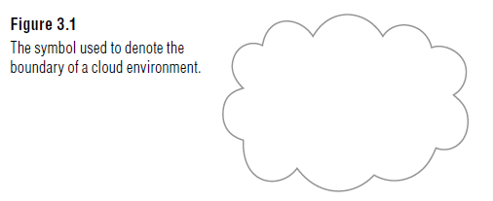
Basic Concepts and Terminology
Cloud :A cloud refers to a distinct IT environment that is designed for the purpose of remotely provisioning scalable and measured IT resources. The term originated as a metaphor for the Internet which is, in essence, a network of networks providing remote access to a set of decentralized IT resources.
The symbol of a cloud was commonly used to represent the Internet in a variety of specifications and mainstream documentation of Web-based architectures. This same symbol is now used to specifically represent the boundary of a cloud environment, as shown in Figure.
Internet provides open access to many Web-based IT resources, a cloud is typically privately owned and offers access to IT resources that is metered.

Slide 15
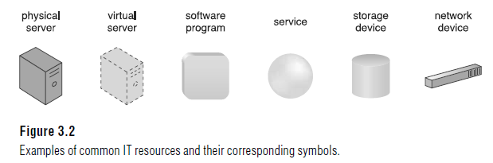
Basic Concepts and Terminology
IT Resource
An IT resource is a physical or virtual IT-related artifact that can be either software based, such as a virtual server or a custom software program, or hardware-based, such as a physical server or a network device (Figure).

Slide 16
Basic Concepts and Terminology
On Premise: An IT resource that is hosted in a conventional IT enterprise within an organizational boundary. The term “on-premise” is another way of stating “on the premises of a controlled IT environment that is not cloud-based.
An on-premise IT resource can access and interact with a cloud-based IT resource and can be moved to a cloud, thereby changing it to a cloud-based IT resource.
Redundant deployments of an IT resource can exist in both on-premise and cloud based environments.
Cloud Providers and Cloud Consumers:
The party that provides cloud-based IT resources is the cloud provider. The party that uses cloud-based IT resources is the cloud consumer. These terms represent roles usually assumed by organizations in relation to clouds and corresponding cloud provisioning contracts.

Slide 17
Basic Concepts and Terminology
Scaling: Scaling, from an IT resource perspective, represents the ability of the IT resource to handle increased or decreased usage demands.
The following are types of scaling:
Horizontal Scaling – scaling out and scaling in
Vertical Scaling – scaling up and scaling down
Horizontal Scaling
The allocating or releasing of IT resources that are of the same type is referred to as horizontal scaling (Figure).
The horizontal allocation of resources is referred to as scaling out and the horizontal releasing of resources is referred to as scaling in. Horizontal scaling is a common form of scaling within cloud environments.

Slide 18
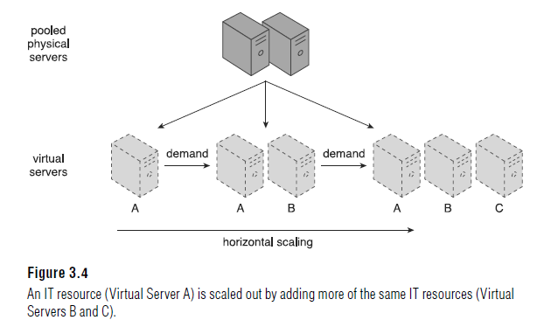
Basic Concepts and Terminology
Scaling

Slide 19
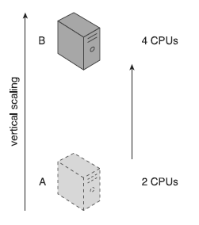
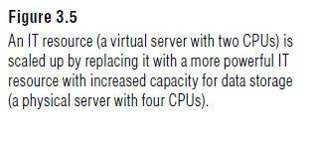
Basic Concepts and Terminology
Vertical Scaling: When an existing IT resource is replaced by another with higher or lower capacity, vertical scaling is considered to have occurred (Figure). Specifically, the replacing of an IT resource with another that has a higher capacity is referred to as scaling up and the replacing an IT resource with another that has a lower capacity is considered scaling down.
Vertical scaling is less common in cloud environments due to the downtime required while the replacement is taking place.

Slide 20
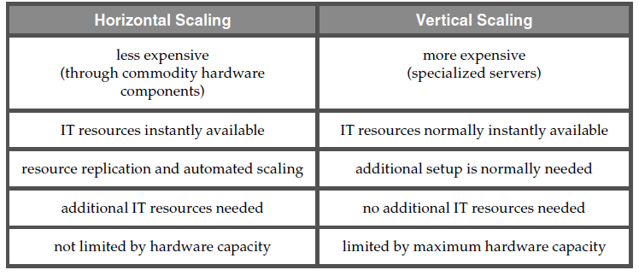
Basic Concepts and Terminology
Scaling

Slide 21
Cloud Service
A cloud is a remotely accessible environment, not all IT resources residing within a cloud can be made available for remote access.
For example, a database or a physical server deployed within a cloud may only be accessible by other IT resources that are within the same cloud.
A software program with a published API may be deployed specifically to enable access by remote clients.
A cloud service is any IT resource that is made remotely accessible via a cloud.
A cloud service can exist as a simple Web-based software program with a technical interface invoked via the use of a messaging protocol, or as a remote access point for administrative tools or larger environments and other IT resources.

Slide 22
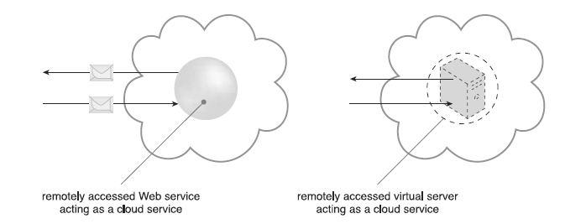
Cloud Service
The driving motivation behind cloud computing is to provide IT resources as services that encapsulate other IT resources, while offering functions for clients to use and leverage remotely.
A multitude of models for generic types of cloud services have emerged, most of which are labeled with the “as-a-service” suffix.

Slide 23
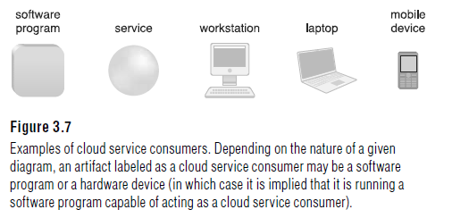
Cloud Service Consumer
The cloud service consumer is a temporary runtime role assumed by a software program when it accesses a cloud service.
Common Types of cloud service consumers:

Slide 24
Goals and Benefits
The common benefi ts associated with adopting cloud computing are:
Reduced Investments and Proportional Costs:
Public cloud providers base their business model on the mass-acquisition of IT resources that are then made available to cloud consumers via attractively priced leasing packages.
The most common economic rationale for investing in cloud-based IT resources is in the reduction or outright elimination of up-front IT investments, namely hardware and software purchases and ownership costs.
Measured operational expenditures (directly related to business performance) to replace anticipated capital expenditures. This is also referred to as proportional costs.
The same rationale applies to operating systems, middleware or platform software, and application software. Pooled IT resources are made available to and shared by multiple cloud consumers, resulting in increased or even maximum possible utilization.

Slide 25
Goals and Benefits
Common measurable benefits to cloud consumers include:
On-demand access to pay-as-you-go computing resources on a short-term basis (such as processors by the hour), and the ability to release these computing resources when they are no longer needed.
The perception of having unlimited computing resources that are available on demand, thereby reducing the need to prepare for provisioning.
The ability to add or remove IT resources at a fine-grained level, such as modifying available storage disk space by single gigabyte increments.
Abstraction of the infrastructure so applications are not locked into devices or locations and can be easily moved if needed.

Slide 26
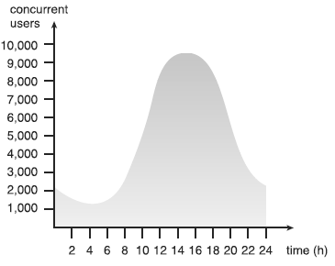
Goals and Benefits
Increased Scalability
By providing pools of IT resources, along with tools and technologies designed to leverage them collectively, clouds can instantly and dynamically allocate IT resources to cloud consumers, on-demand or via the cloud consumer’s direct configuration.
This empowers cloud consumers to scale their cloud-based IT resources to accommodate processing fluctuations and peaks automatically or manually and Cloud-based IT resources can be released (automatically or manually) as processing demands decrease.

Slide 27
Goals and Benefits
Increased Availability and Reliability
The availability and reliability of IT resources are directly associated with tangible business benefits.
Runtime failures that are not immediately corrected can have a more significant impact during high-volume usage periods.
Unexpected failure can decrease overall customer confidence.
An IT resource with increased availability is accessible for longer periods of time (for example, 22 hours out of a 24 hour day). Cloud providers generally offer “ resilient” IT resources for which they are able to guarantee high levels of availability.
An IT resource with increased reliability is able to better avoid and recover from exception conditions. The modular architecture of cloud environments provides extensive failover support that increases reliability.

Slide 28
Summary of Key Points
Cloud environments are comprised of highly extensive infrastructure that offers pools of IT resources that can be leased using a pay-for-use model whereby only the actual usage of the IT resources is billable.
When compared to equivalent on-premise environments, clouds provide the potential for reduced initial investments and operational costs proportional to measured usage.
The inherent ability of a cloud to scale IT resources enables organizations to accommodate unpredictable usage fluctuations without being limited by pre-defined thresholds that may turn away usage requests from customers.
Conversely, the ability of a cloud to decrease required scaling is a feature that relates directly to the proportional costs benefit.
By leveraging cloud environments to make IT resources highly available and reliable, organizations are able to increase quality-of-service guarantees to customers and further reduce or avoid potential loss of business resulting from unanticipated runtime failures.

Slide 29
Risks and Challenges
Increased Security Vulnerabilities:
The moving of business data to the cloud means that the responsibility over data security becomes shared with the cloud provider.
It can be difficult to establish a security architecture that spans such a trust boundary without introducing vulnerabilities, unless cloud consumers and cloud providers happen to support the same or compatible security frameworks—which is unlikely with public clouds.
The overlapping of trust boundaries and the increased exposure of data can provide malicious cloud consumers (human and automated) with greater opportunities to attack IT resources and steal or damage business data.

Slide 30
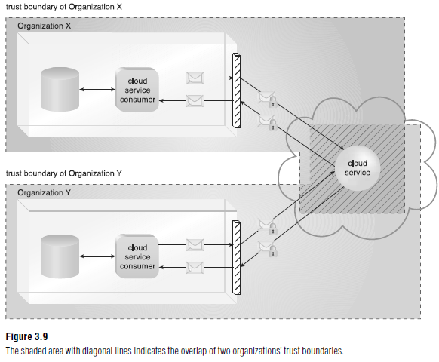
Risks and Challenges

Slide 31
Risks and Challenges
Reduced Operational Governance Control:
A cloud governance system is established through SLAs, given the “as-a-service” nature of cloud computing. A cloud consumer must keep track of the actual service level being offered and the other warranties that are made by the cloud provider.
For e.g. An unreliable cloud provider may not maintain the guarantees it makes in the SLAs that were published for its cloud services. This can jeopardize the quality of the cloud consumer solutions that rely on these cloud services.
Longer geographic distances between the cloud consumer and cloud provider can require additional network hops that introduce fluctuating latency and potential bandwidth constraints.
Legal contracts, when combined with SLAs, technology inspections, and monitoring, can mitigate governance risks and issues.

Slide 32
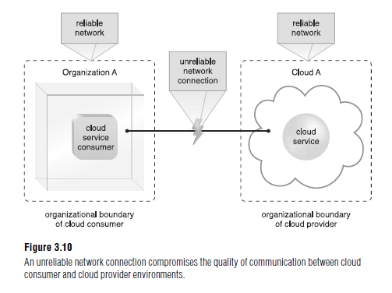
Risks and Challenges
Reduced Operational Governance Control:

Slide 33
Risks and Challenges
Limited Portability Between Cloud Providers
Due to a lack of established industry standards within the cloud computing industry, public clouds are commonly proprietary to various extents.
For cloud consumers that have custom-built solutions with dependencies on these proprietary environments, it can be challenging to move from one cloud provider to another.
Portability is a measure used to determine the impact of moving cloud consumer IT resources and data between clouds.

Slide 34
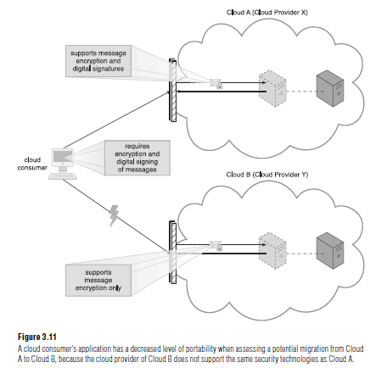
Risks and Challenges

Slide 35
Risks and Challenges
Multi-Regional Compliance and Legal Issues:
Third-party cloud providers will frequently establish data centers in affordable or convenient geographical locations.
Cloud consumers will often not be aware of the physical location of their IT resources and data when hosted by public clouds.
For some organizations, this can pose serious legal concerns pertaining to industry or government regulations that specify data privacy and storage policies.
For example, some UK laws require personal data belonging to UK citizens to be kept within the United Kingdom.

Slide 36
Risks and Challenges
Multi-Regional Compliance and Legal Issues:
Another potential legal issue pertains to the accessibility and disclosure of data. Countries have laws that require some types of data to be disclosed to certain government agencies or to the subject of the data.
For example, a European cloud consumer’s data that is located in the U.S. can be more easily accessed by government agencies (due to the U.S. Patriot Act) when compared to data located in many European Union countries.
Most regulatory frameworks recognize that cloud consumer organizations are ultimately responsible for the security, integrity, and storage of their own data, even when it is held by an external cloud provider.

Slide 37
Summary: Risks and Challenges
Cloud environments can introduce distinct security challenges, some of which pertain to overlapping trust boundaries imposed by a cloud provider sharing IT resources with multiple cloud consumers.
A cloud consumer’s operational governance can be limited within cloud environments due to the control exercised by a cloud provider over its platforms.
The portability of cloud-based IT resources can be inhibited by dependencies upon proprietary characteristics imposed by a cloud.
The geographical location of data and IT resources can be out of a cloud consumer’s control when hosted by a third-party cloud provider.
This can introduce various legal and regulatory compliance concerns.

Slide 38
Fundamental Concepts and Models
Roles and Boundaries:
Organizations and humans can assume different types of pre-defined roles depending on how they relate to and / or interact with a cloud and its hosted IT resources. Each of the upcoming roles participants in and carries out responsibilities in relation to cloud-based activity.
Cloud Provider: The organization that provides cloud-based IT resources is the cloud provider.
Cloud providers normally own the IT resources that are made available for lease by cloud consumers; however, some cloud providers also “resell” IT resources leased from other cloud providers.

Slide 39
Fundamental Concepts and Models
Roles and Boundaries:
Organizations and humans can assume different types of pre-defined roles depending on how they relate to and / or interact with a cloud and its hosted IT resources. Each of the upcoming roles participants in and carries out responsibilities in relation to cloud-based activity.
Cloud Provider: The organization that provides cloud-based IT resources is the cloud provider.
Cloud providers normally own the IT resources that are made available for lease by cloud consumers; however, some cloud providers also “resell” IT resources leased from other cloud providers.

Slide 40
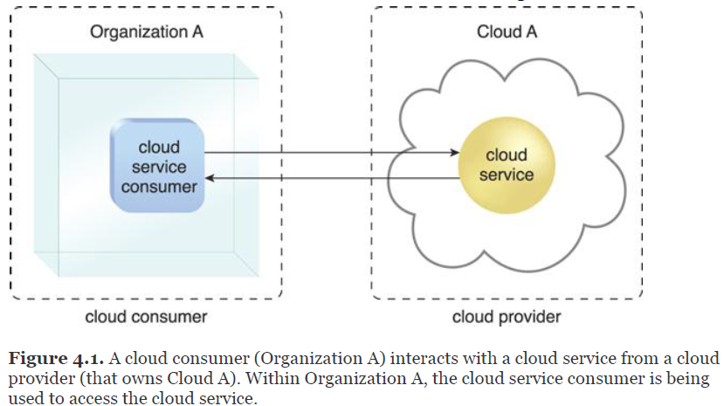
Fundamental Concepts and Models
Cloud consumer: An organization (or a human) that has a formal contract or arrangement with a cloud provider to use IT resources made available by the cloud provider. Specifically, the cloud consumer uses a cloud service consumer to access a cloud service.

Slide 41
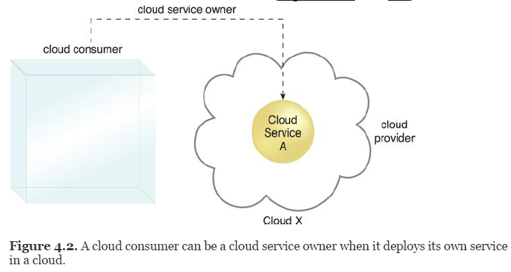
Fundamental Concepts and Models
Cloud Service Owner : The person or organization that legally owns a cloud service is called a cloud service owner. The cloud service owner can be the cloud consumer, or the cloud provider that owns the cloud within which the cloud service resides.

Slide 42
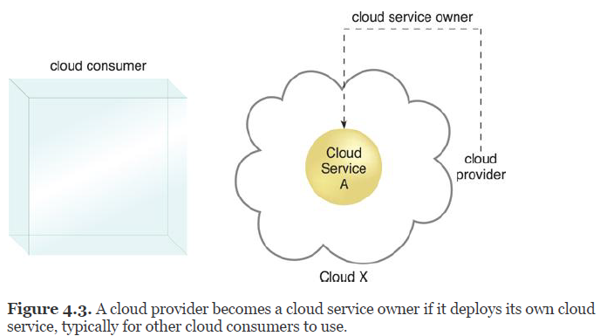
Fundamental Concepts and Models
Several cloud consumer organizations develop and deploy cloud services in clouds owned by other parties for the purpose of making the cloud services available to the general public.

Slide 43
Fundamental Concepts and Models
Cloud Resource Administrator : A cloud resource administrator is the person or organization responsible for administering a cloud-based IT resource (including cloud services). The cloud resource administrator can be (or belong to) the cloud consumer or cloud provider of the cloud within which the cloud service resides.
It can be (or belong to) a third-party organization contracted to administer the cloud-based IT resource. For example, a cloud service owner can contract a cloud resource administrator to administer a cloud service (Figures).

Slide 44
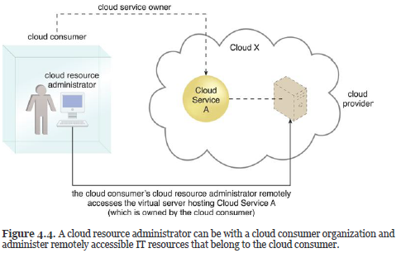
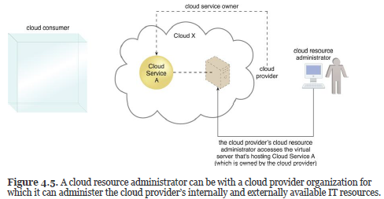
Fundamental Concepts and Models

Slide 45
Additional Roles
The NIST Cloud Computing Reference Architecture defines the following supplementary roles:
Cloud Auditor – A third-party (often accredited) that conducts independent assessments of cloud environments assumes the role of the cloud auditor. The main purpose of the cloud auditor role is to provide an unbiased assessment (and possible endorsement) of a cloud environment to help strengthen the trust relationship between cloud consumers and cloud providers.
Cloud Broker – This role is assumed by a party that assumes the responsibility of managing and negotiating the usage of cloud services between cloud consumers and cloud providers.
Cloud Carrier – The party responsible for providing the wire-level connectivity between cloud consumers and cloud providers assumes the role of the cloud carrier. This role is often assumed by network and telecommunication providers.

Slide 46
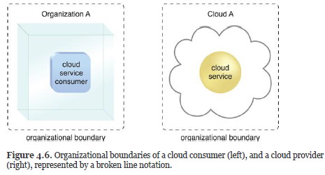
Organizational Boundary
An organizational boundary represents the physical perimeter that surrounds a set of IT resources that are owned and governed by an organization.
The organizational boundary does not represent the boundary of an actual organization, only an organizational set of IT assets and IT resources. Similarly, clouds have an organizational boundary (Fig.).

Slide 47
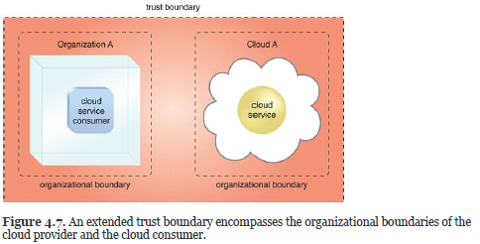
Trust Boundary
When an organization assumes the role of cloud consumer to access cloud-based IT resources, it needs to extend its trust beyond the physical boundary of the organization to include parts of the cloud environment.
A trust boundary is a logical perimeter that typically spans beyond physical boundaries to represent the extent to which IT resources are trusted (Figure). When analyzing cloud environments, the trust boundary is most frequently associated with the trust issued by the organization acting as the cloud consumer.

Slide 48
Summary: Roles
Common roles associated with cloud-based interaction and relationships include the cloud provider, cloud consumer, cloud service owner, and cloud resource administrator.
An organizational boundary represents the physical scope of IT resources owned and governed by an organization.

Slide 49
Cloud Characteristics
The following six specific characteristics are common to the majority of cloud environments:
on-demand usage
ubiquitous access
multitenancy (and resource pooling)
elasticity
measured usage
resiliency

Slide 50
Cloud Characteristics
On-Demand Usage
A cloud consumer can unilaterally access cloud-based IT resources giving the cloud consumer the freedom to self-provision these IT resources.
Once configured, usage of the self-provisioned IT resources can be automated, requiring no further human involvement by the cloud consumer or cloud provider. This results in an on-demand usage environment.
Also known as “on-demand self-service usage,” this characteristic enables the service-based and usage-driven features found in mainstream clouds.

Slide 51
Cloud Characteristics
Ubiquitous Access
Ubiquitous access represents the ability for a cloud service to be widely accessible.
Establishing ubiquitous access for a cloud service can require support for a range of devices, transport protocols, interfaces, and security technologies.
To enable this level of access generally requires that the cloud service architecture be tailored to the particular needs of different cloud service consumers.

Slide 52
Cloud Characteristics
Multitenancy (and Resource Pooling)
The characteristic of a software program that enables an instance of the program to serve different consumers (tenants) whereby each is isolated from the other, is referred to as multitenancy.
A cloud provider pools its IT resources to serve multiple cloud service consumers by using multitenancy models that frequently rely on the use of virtualization technologies.
Through the use of multitenancy technology, IT resources can be dynamically assigned and reassigned, according to cloud service consumer demands.
Different physical and virtual IT resources are dynamically assigned and reassigned according to cloud consumer demand, typically followed by execution through statistical multiplexing.
Resource pooling is commonly achieved through multitenancy technology, and therefore encompassed by this multitenancy characteristic.

Slide 53
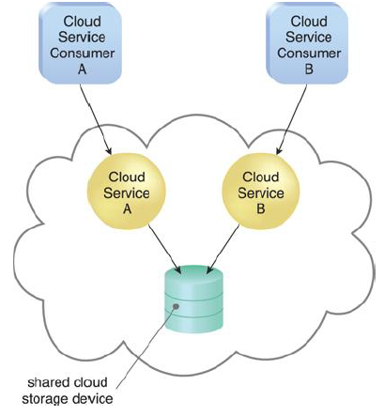
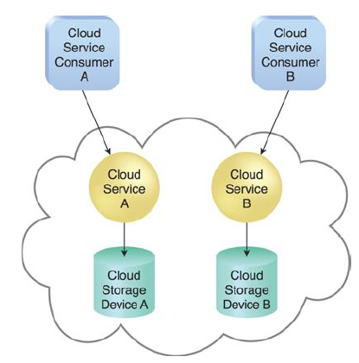
Cloud Characteristics

Slide 54
Cloud Characteristics
Elasticity
Elasticity is the automated ability of a cloud to transparently scale IT resources, as required in response to runtime conditions or as pre-determined by the cloud consumer or cloud provider. Elasticity is often considered a core justification for the adoption of cloud computing, primarily due to the fact that it is closely associated with the Reduced Investment and Proportional Costs benefit. Cloud providers with vast IT resources can offer the greatest range of elasticity.

Slide 55
Cloud Characteristics
Measured Usage
The measured usage characteristic represents the ability of a cloud platform to keep track of the usage of its IT resources, primarily by cloud consumers. Based on what is measured, the cloud provider can charge a cloud consumer only for the IT resources actually used and/or for the timeframe during which access to the IT resources was granted. In this context, measured usage is closely related to the on-demand characteristic.
Measured usage is not limited to tracking statistics for billing purposes. It also encompasses the general monitoring of IT resources and related usage reporting (for both cloud provider and cloud consumers).

Slide 56
Cloud Characteristics
Resiliency
Resilient computing is a form of failover that distributes redundant implementations of IT resources across physical locations. IT resources can be pre-configured so that if one becomes deficient, processing is automatically handed over to another redundant implementation. Within cloud computing, the characteristic of resiliency can refer to redundant IT resources within the same cloud (but in different physical locations) or across multiple clouds. Cloud consumers can increase both the reliability and availability of their applications by leveraging the resiliency of cloud-based IT resources

Slide 57
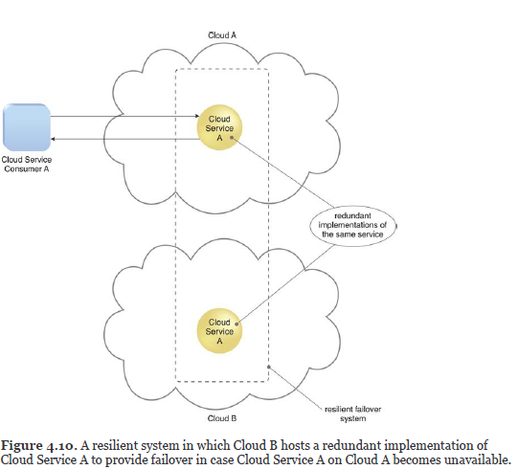
Cloud Characteristics

Slide 58
Cloud Delivery Models
Platform-as-a-Service (PaaS)
The PaaS delivery model represents a pre-defined “ready-to-use” environment typically comprised of already deployed and configured IT resources.
Specifically, PaaS relies on (and is primarily defined by) the usage of a ready made environment that establishes a set of pre-packaged products and tools used to support the entire delivery lifecycle of custom applications.
Common reasons a cloud consumer would use and invest in a PaaS environment include:
The cloud consumer wants to extend on-premise environments into the cloud for scalability and economic purposes.
The cloud consumer uses the ready-made environment to entirely substitute an on-premise environment.
The cloud consumer wants to become a cloud provider and deploys its own cloud services to be made available to other external cloud consumers.

Slide 59
Summary
On-demand usage is the ability of a cloud consumer to self-provision and use necessary cloud-based services without requiring cloud provider interaction.
This characteristic is related to measured usage, which represents the ability of a cloud to measure the usage of its IT resources.
Ubiquitous access allows cloud-based services to be accessed by diverse cloud service consumers, while multi-tenancy is the ability of a single instance of an IT resource to transparently serve multiple cloud consumers simultaneously.
The elasticity characteristic represents the ability of a cloud to transparently and automatically scale IT resources out or in.
Resiliency pertains to a cloud’s inherent failover features.

Slide 60
Cloud Delivery Models
A cloud delivery model represents a specific, pre-packaged combination of IT resources offered by a cloud provider.
Three common cloud delivery models have become widely established and formalized:
Infrastructure-as-a-Service (IaaS)
Platform-as-a-Service (PaaS)
Software-as-a-Service (SaaS)
Specialized variations:
Storage-as-a-Service
Database-as-a-Service
Security-as-a-Service
Communication-as-a-Service
Integration-as-a-Service
Testing-as-a-Service
Process-as-a-Service

Slide 61
Cloud Delivery Models: IaaS
Infrastructure-as-a-Service (IaaS)
The IaaS delivery model represents a self-contained IT environment comprised of infrastructure-centric IT resources that can be accessed and managed via cloud service-based interfaces and tools.
This environment can include hardware, network, connectivity, operating systems, and other “raw” IT resources.
With IaaS, IT resources are typically virtualized and packaged into bundles that simplify up-front runtime scaling and customization of the infrastructure.
The general purpose of an IaaS environment is to provide cloud consumers with a high level of control and responsibility over its configuration and utilization.
The IT resources provided by IaaS are generally not pre-configured, placing the administrative responsibility directly upon the cloud consumer. This model is therefore used by cloud consumers that require a high level of control over the cloud-based environment they intend to create.

Slide 62
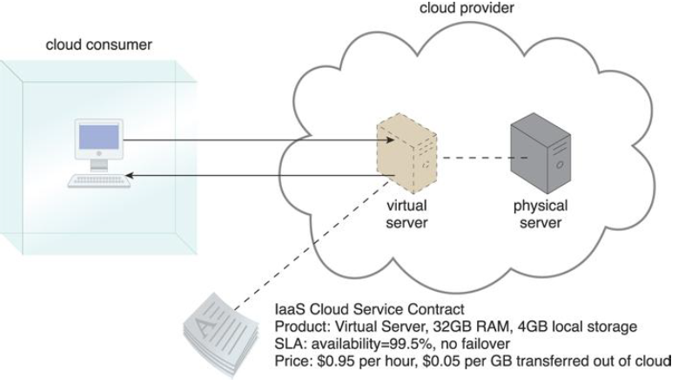
Cloud Delivery Models: IaaS
IT resources available through IaaS environments are generally offered as freshly initialized virtual instances. A central and primary IT resource within a typical IaaS environment is the virtual server. Virtual servers are leased by specifying server hardware requirements, such as processor capacity, memory, and local storage space, as shown in Figure.

Slide 63
Cloud Delivery Models: PaaS
Platform-as-a-Service (PaaS)
The PaaS delivery model represents a pre-defined “ready-to-use” environment typically comprised of already deployed and configured IT resources.
Common reasons a cloud consumer would use and invest in a PaaS environment include:
The cloud consumer wants to extend on-premise environments into the cloud for scalability and economic purposes.
The cloud consumer uses the ready-made environment to entirely substitute an on-premise environment.
The cloud consumer wants to become a cloud provider and deploys its own cloud services to be made available to other external cloud consumers.
PaaS products are available with different development stacks. For example, Google App Engine offers a Java and Python-based environment.

Slide 64
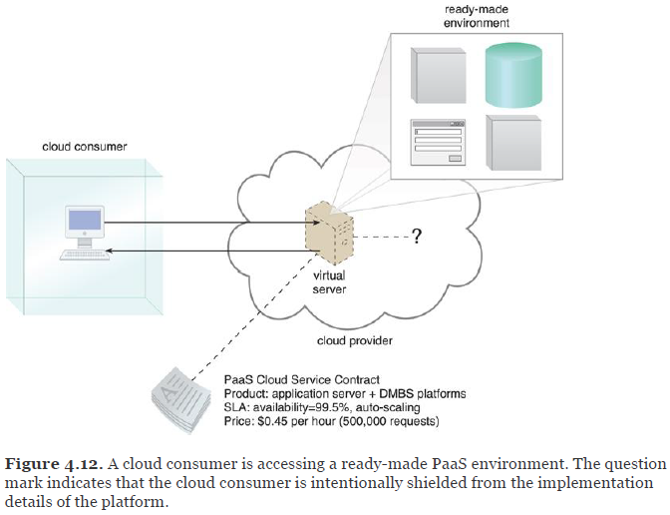
Cloud Delivery Models: PaaS

Slide 65
Cloud Delivery Models: SaaS
Software-as-a-Service (SaaS)
A software program positioned as a shared cloud service and made available as a “product” or generic utility represents the typical profile of a SaaS offering.
The SaaS delivery model is typically used to make a reusable cloud service widely available (often commercially) to a range of cloud consumers. An entire marketplace exists around SaaS products that can be leased and used for different purposes and via different terms
A cloud consumer is generally granted very limited administrative control over a SaaS implementation. It is most often provisioned by the cloud provider, but it can be legally owned by whichever entity assumes the cloud service owner role.
For example, an organization acting as a cloud consumer while using and working with a PaaS environment can build a cloud service that it decides to deploy in that same environment as a SaaS offering.

Slide 66
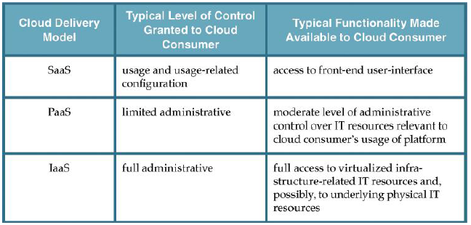
Comparing Cloud Delivery Models

Slide 67
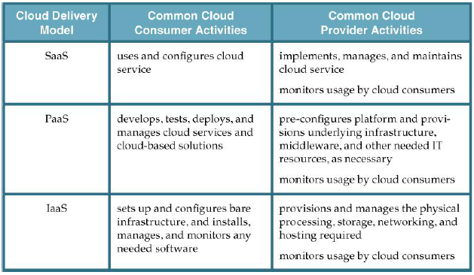
Comparing Cloud Delivery Models
Typical activities carried out by cloud consumers and cloud providers in relation to the cloud delivery models

Slide 68
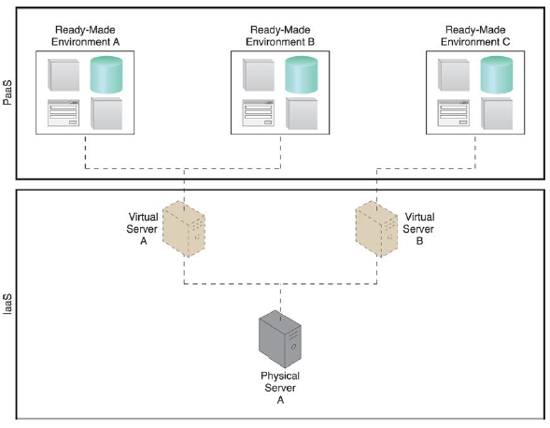
Comparing Cloud Delivery Models
The three base cloud delivery models comprise a natural provisioning hierarchy, allowing for opportunities for the combined application of the models to be explored.
IaaS + PaaS
A PaaS environment will be built upon an underlying infrastructure comparable to the physical and virtual servers and other IT resources provided in an IaaS environment.

Slide 69
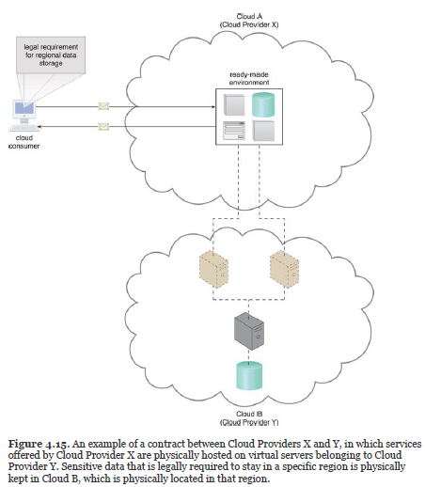
Comparing Cloud Delivery Models
The motivation for such an arrangement may be influenced by economics or maybe because the first cloud provider is close to exceeding its existing capacity by serving other cloud consumers. Or, perhaps a particular cloud consumer imposes a legal requirement for data to be physically stored in a specific region (different from where the first cloud provider’s cloud resides), as illustrated

Slide 70
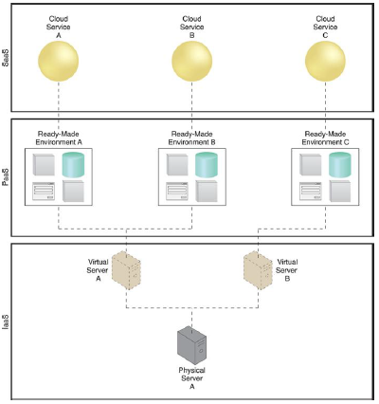
Comparing Cloud Delivery Models
IaaS + PaaS + SaaS
All three cloud delivery models can be combined to establish layers of IT resources that build upon each other. For example, by adding on to the preceding layered architecture shown in Figure, the ready-made environment provided by the PaaS environment can be used by the cloud consumer organization to develop and deploy its own SaaS cloud services that it can then make available as commercial products (Figure).

Slide 71
Summary
The IaaS cloud delivery model offers cloud consumers a high level of administrative control over “raw” infrastructure-based IT resources.
The PaaS cloud delivery model enables a cloud provider to offer a pre-configured environment that cloud consumers can use to build and deploy cloud services and solutions, albeit with decreased administrative control.
SaaS is a cloud delivery model for shared cloud services that can be positioned as commercialized products hosted by clouds.
Different combinations of IaaS, PaaS, and SaaS are possible, depending on how cloud consumers and cloud providers choose to leverage the natural hierarchy established by these base cloud delivery models.

Slide 72
Cloud Deployment Models
A cloud deployment model represents a specific type of cloud environment, primarily distinguished by ownership, size, and access.
There are four common cloud deployment models:
Public cloud
Community cloud
Private cloud
Hybrid cloud

Slide 73
Cloud Deployment Models
Public Clouds
A public cloud is a publicly accessible cloud environment owned by a third-party cloud provider. The IT resources on public clouds are usually provisioned via the previously described cloud delivery models and are generally offered to cloud consumers at a cost or are commercialized via other avenues (such as advertisement).
The cloud provider is responsible for the creation and on-going maintenance of the public cloud and its IT resources.

Slide 74
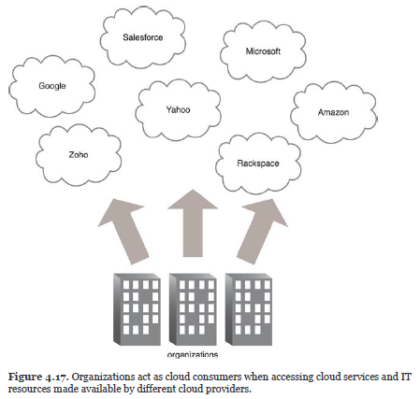
Cloud Deployment Models
Public Clouds

Slide 75
Cloud Deployment Models
Private Clouds
A private cloud is owned by a single organization. Private clouds enable an organization to use cloud computing technology as a means of centralizing access to IT resources by different parts, locations, or departments of the organization.
The use of a private cloud can change how organizational and trust boundaries are defined and applied. The actual administration of a private cloud environment may be carried out by internal or outsourced staff.
With a private cloud, the same organization is technically both the cloud consumer and cloud provider

Slide 76
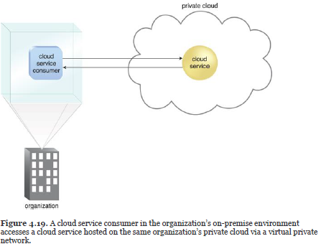
Cloud Deployment Models

Slide 77
Cloud Deployment Models
Hybrid Clouds
A hybrid cloud is a cloud environment comprised of two or more different cloud deployment models. For example, a cloud consumer may choose to deploy cloud services processing sensitive data to a private cloud and other, less sensitive cloud services to a public cloud. The result of this combination is a hybrid deployment model.
Hybrid deployment architectures can be complex and challenging to create and maintain due to the potential disparity in cloud environments and the fact that management responsibilities are typically split between the private cloud provider organization and the public cloud provider.

Slide 78
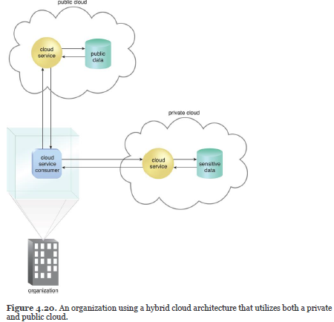
Cloud Deployment Models

Slide 79
Cloud Deployment Models
Other Cloud Deployment Models
Additional variations of the four base cloud deployment models can exist.
Examples include:
Virtual Private Cloud – Also known as a “dedicated cloud” or “hosted cloud,” this model results in a self-contained cloud environment hosted and managed by a public cloud provider, and made available to a cloud consumer.
Inter-Cloud – This model is based on an architecture comprised of two or more inter-connected clouds.

